Slide 1

Chapter 2
Instructions: Language of the Computer
Notes:
The University of Adelaide, School of Computer Science
Chapter 2 — Instructions: Language of the Computer

Slide 2

Conditional Operations
Branch to a labeled instruction if a condition is true
  Otherwise, continue sequentially
beq rs, rt, L1
  if (rs == rt) branch to instruction labeled L1;
bne rs, rt, L1
  if (rs != rt) branch to instruction labeled L1;
j L1
  unconditional jump to instruction labeled L1
§2.7 Instructions for Making Decisions
Chapter 2 — Instructions: Language of the Computer — <number>
Notes:
The University of Adelaide, School of Computer Science
Chapter 2 — Instructions: Language of the Computer

Slide 3
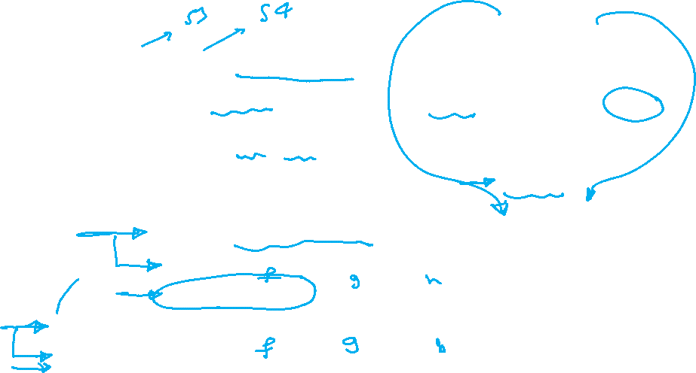

Compiling If Statements
C code:
if (i==j) f = g+h;
else f = g-h;
  f, g, … in $s0, $s1, …
Compiled MIPS code:
bne $s3, $s4, Else
add $s0, $s1, $s2
j Exit
Else: sub $s0, $s1, $s2
Exit: …
Assembler calculates addresses
Chapter 2 — Instructions: Language of the Computer — <number>
Notes:
The University of Adelaide, School of Computer Science
Chapter 2 — Instructions: Language of the Computer

Slide 4
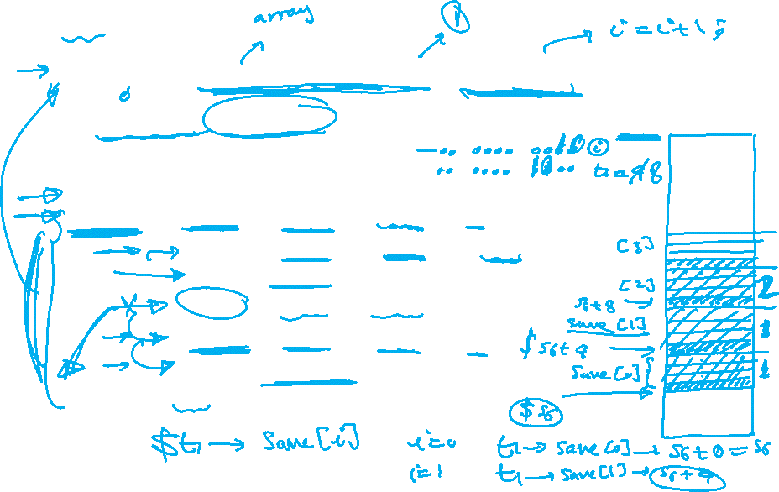
Compiling Loop Statements
C code:
while (save[i] == k) i += 1;
  i in $s3, k in $s5, address of save in $s6
Compiled MIPS code:
Loop: sll $t1, $s3, 2
add $t1, $t1, $s6
lw $t0, 0($t1)
bne $t0, $s5, Exit
addi $s3, $s3, 1
j Loop
Exit: …
Chapter 2 — Instructions: Language of the Computer — <number>
Notes:
The University of Adelaide, School of Computer Science
Chapter 2 — Instructions: Language of the Computer

Slide 5
Basic Blocks
A basic block is a sequence of instructions with
  No embedded branches (except at end)
  No branch targets (except at beginning)
A compiler identifies basic blocks for optimization
An advanced processor can accelerate execution of basic blocks
Chapter 2 — Instructions: Language of the Computer — <number>
Notes:
The University of Adelaide, School of Computer Science
Chapter 2 — Instructions: Language of the Computer

Slide 6
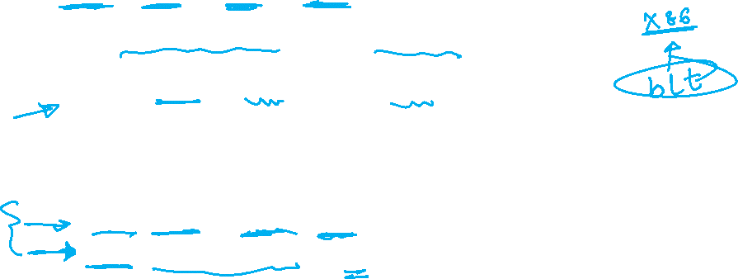
More Conditional Operations
Set result to 1 if a condition is true
  Otherwise, set to 0
slt rd, rs, rt
  if (rs < rt) rd = 1; else rd = 0;
slti rt, rs, constant
  if (rs < constant) rt = 1; else rt = 0;
Use in combination with beq, bne
  slt $t0, $s1, $s2 # if ($s1 < $s2)
  bne $t0, $zero, L # branch to L
Chapter 2 — Instructions: Language of the Computer — <number>
Notes:
The University of Adelaide, School of Computer Science
Chapter 2 — Instructions: Language of the Computer

Slide 7

Branch Instruction Design
Why not blt, bge, etc?
Hardware for <, ≥, … slower than =, ≠
  Combining with branch involves more work per instruction, requiring a slower clock
  All instructions penalized!
beq and bne are the common case
This is a good design compromise
Chapter 2 — Instructions: Language of the Computer — <number>
Notes:
The University of Adelaide, School of Computer Science
Chapter 2 — Instructions: Language of the Computer

Slide 8

Signed vs. Unsigned
Signed comparison: slt, slti
Unsigned comparison: sltu, sltui
Example
  $s0 = 1111 1111 1111 1111 1111 1111 1111 1111
  $s1 = 0000 0000 0000 0000 0000 0000 0000 0001
  slt $t0, $s0, $s1 # signed
    –1 < +1 ⇒ $t0 = 1
  sltu $t0, $s0, $s1 # unsigned
    +4,294,967,295 > +1 ⇒ $t0 = 0
Chapter 2 — Instructions: Language of the Computer — <number>
Notes:
The University of Adelaide, School of Computer Science
Chapter 2 — Instructions: Language of the Computer

